Slide 1
About this deck
This “Guide to working from home” is a document that Microsoft created to provide their employees with guidance, tips, and resources during the COVID-19 outbreak.
As the outbreak continues, more and more organizations are recommending remote work, and employees everywhere are adjusting to meeting, chatting, and collaborating exclusively online.
We want to help everyone meet this challenge and are sharing this guide for you to share with your employees. The guide can be shared as is or be used as a starting point to which you can add additional company specific information. Please see the Notes section on each slide for suggestions on what to add. All adaptations, including changes to imagery, are the responsibility of the user.
We hope you find this deck helpful. Join the Enabling Remote Work Community to reach out with questions, connect with others, and share your experiences.

Slide 2
Guide to working from home
General guidance, tips, and resources for employees during the COVID-19 outbreak
As of March 17, 2020

Slide 3
Our global concern
As a global community working together to prevent further spread of the COVID-19 virus, many of you are working from home for the first time, for a more sustained period than you have before, and (in some cases) with others at home with you.
We recognize that, for some of you, working from home is new and can feel difficult. With this guide, we have collected resources, guidance, and tips to help you stay healthy, engaged, and productive.
This guide is for you—to help you set up your workspace, stay connected to each other, and manage your time and well-being.
Notes:
Additional information that can be added to this page:
Where employees can find information about your company’s response to COVID-19
How to connect with HR
How to get technical help

Slide 4

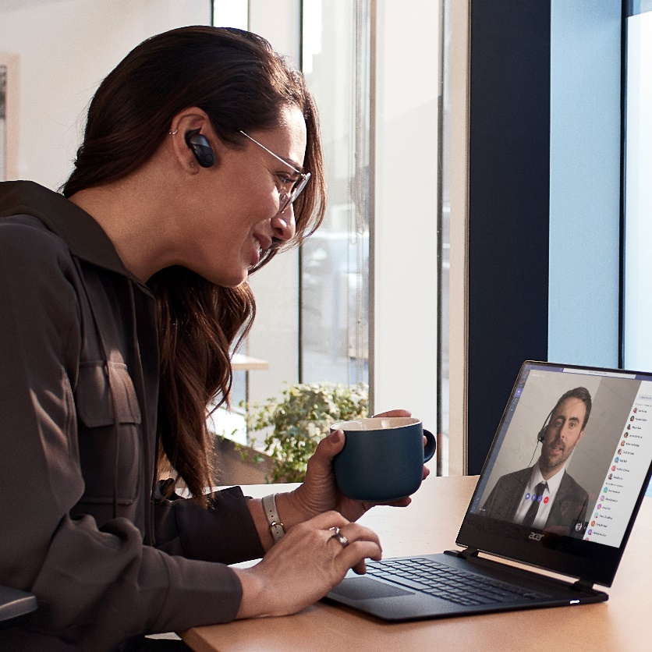
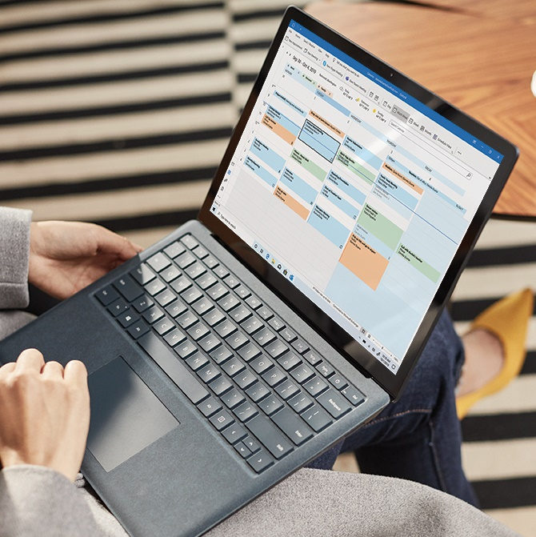

Guide to working from home
Set up your workspace
Stay connected to each other
Manage your time and well-being

Slide 5

Set up your (physical and virtual) workspace

Slide 6
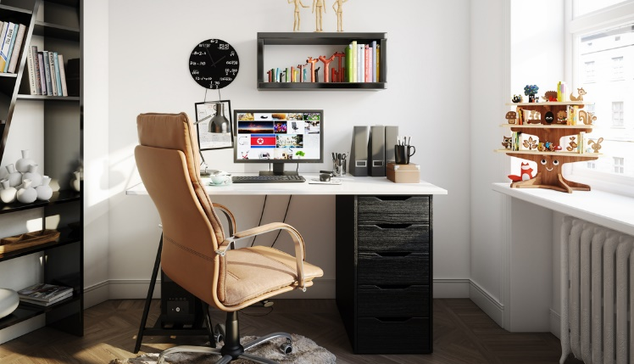


Set up your physical workspace
Take the time to set up a workspace that is safe, comfortable, and where you can work effectively.
A safe and secure space
Find a safe space to work—good ventilation, proper lighting, good ergonomics, and comfortable furniture are just a few things to consider.
Minimize distraction and disruption
If possible, aim for a space with minimal distractions (noise or clutter) and disruptions. We realize this can be challenging with others home as well during this time.
A place for equipment and materials
Identify a ‘work base’ where your equipment and materials can remain undisturbed, even if you shift locations during the day.
Notes:
Throughout this deck, you can use the blue bar to surface links and tips specific to your organization. Additional information that can be added to this page:
- Internal policy or guidance on equipment during COVID-19

Slide 7
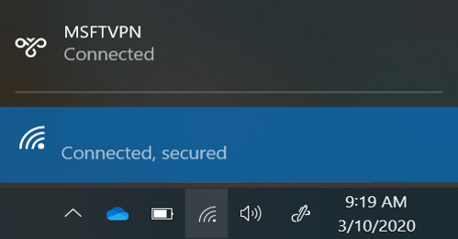

Set up your virtual workspace
Continue to collaborate and be productive from wherever you might be working.
Use your best connection
A wired network connection is best, if possible. When using a wireless connection, consider your distance from the router and obstacles in between that can affect your connection quality.
Think secure, be secure
You can use many apps and sites with a standard internet connection. To securely access internal resources and work with confidential data, you might need to connect via VPN or remote desktop.
Mobile when you need it
Installing the apps you need on your phone is a great alternative when your local internet is experiencing high usage that affects your connectivity.
Notes:
Additional information that can be added to this page:
How to get technical help and/ or open a support ticket
How to set up VPN and remote access
How to access internal resources from home

Slide 8
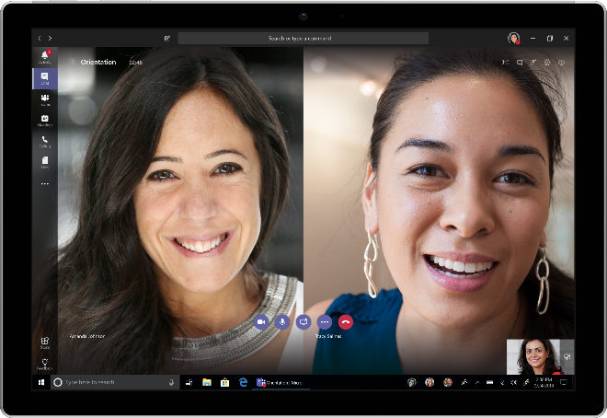
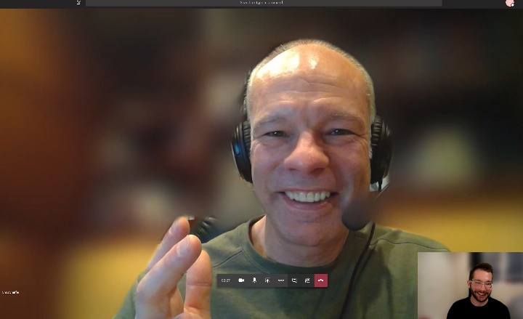



Get your video ready
Using webcam can help connect with colleagues and customers when you are not together in person.
Video on (when possible)
It makes for more inclusive meetings and helps you to be present and engaged in the meeting. It can also help to see facial expressions to increase connection and understanding.
Check your surroundings
Be aware of what is in view and use ‘blur my background’ in Microsoft Teams to help minimize distractions and protect privacy.
Camera framing
Point your camera so your eyes are ~2/3 up the screen and your face is visible.
Video can sometimes strain limited bandwidth so consider turning your camera off if the connection is poor.
Need additional resources for using Teams video? Learn more on the Office support site.

Slide 9
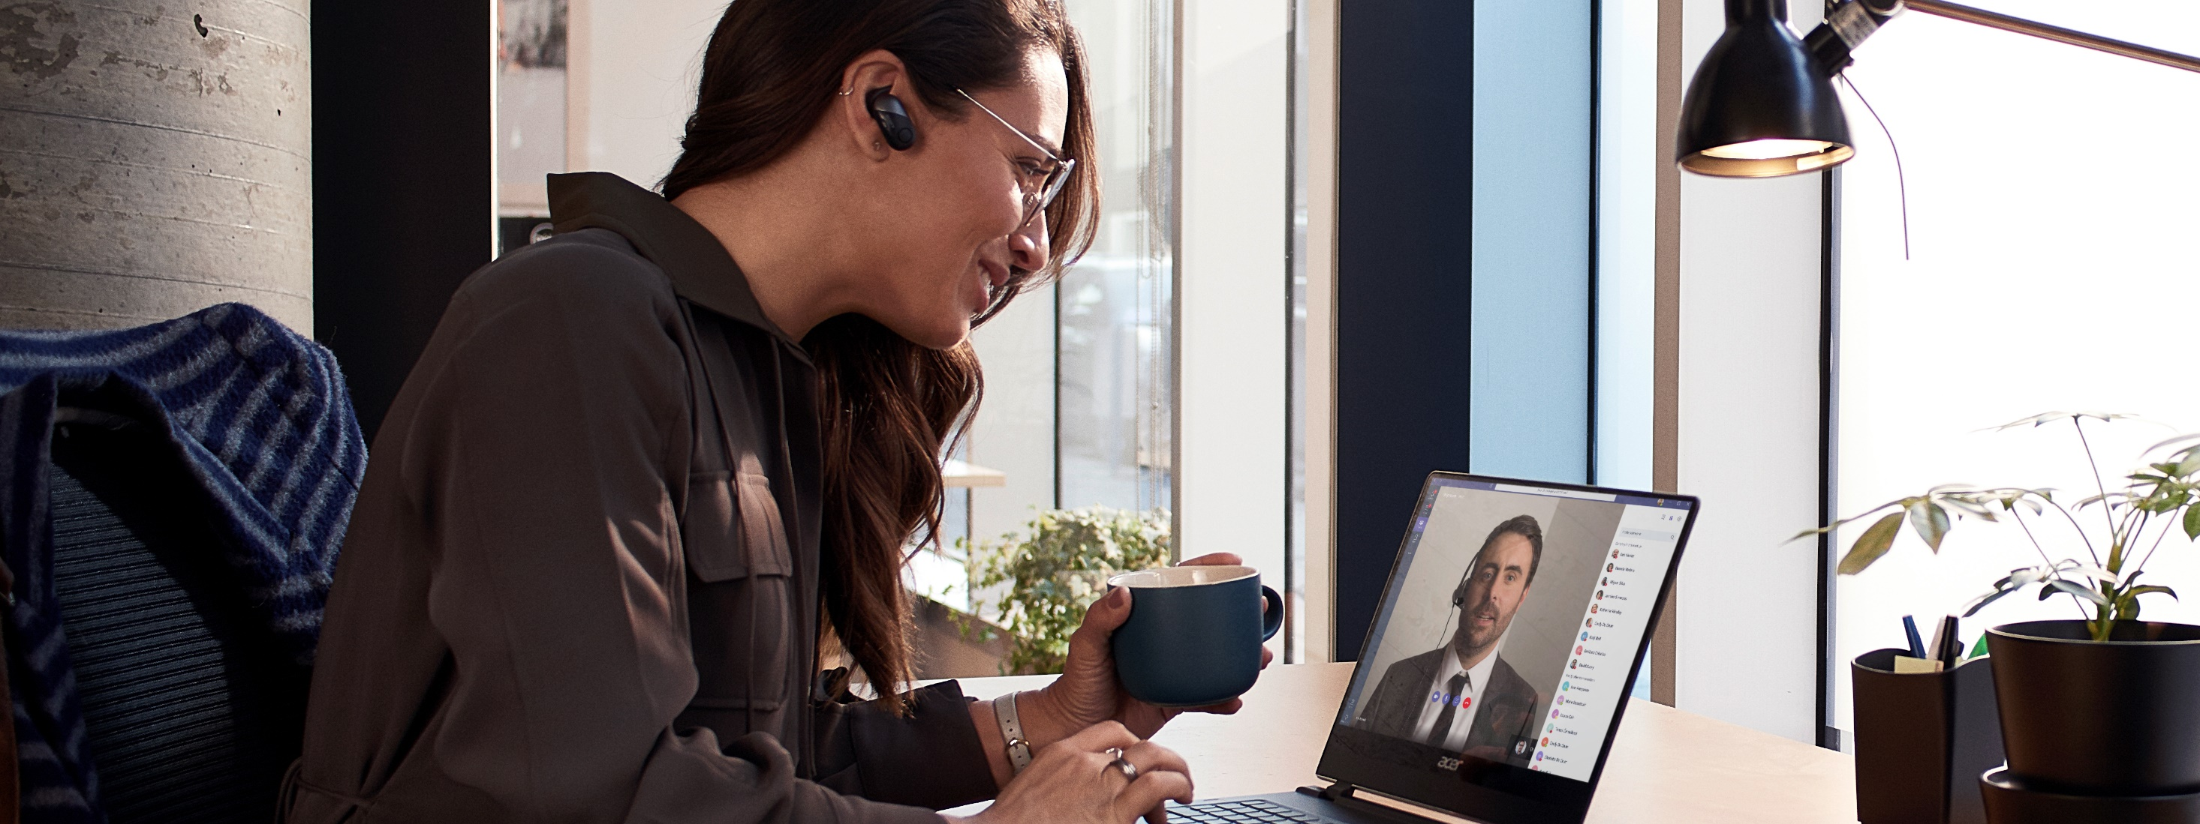
Stay connected to each other

Slide 10

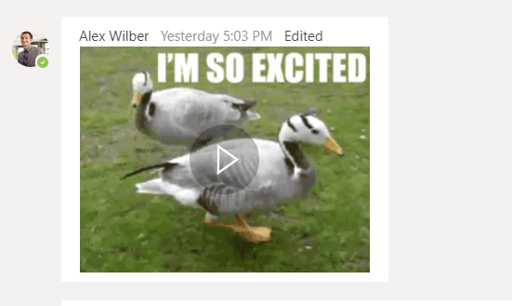
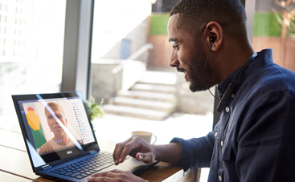
Communicate
There are many ways to stay connected while working from home.
Communicate often
Make it a habit to connect frequently with your colleagues and stakeholders. Open a Teams channel for ongoing conversations or start a shared document to share progress updates.
Make space for fun
Use a Teams channel dedicated to fun—share news, pictures, and stories. Try a GIF, sticker or emoji to express yourself.
Virtual ‘water cooler’
Make up for missing hallway talk or connecting in the kitchenette or café by using chat messages or calling. Set yourself a reminder to check in with people regularly.
Channel conversations in Teams are a great way to keep the whole team in the know.
Watch the Quick Start Videos for a walk-through of Teams and use the Quick Start Guide to learn the Teams basics.

Slide 11
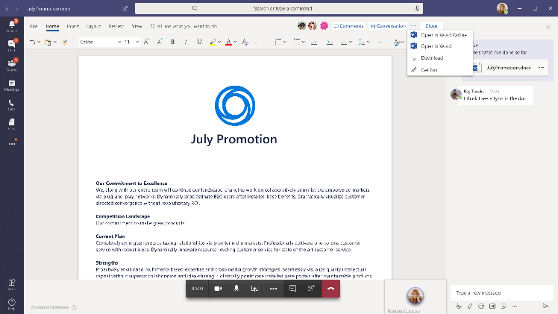
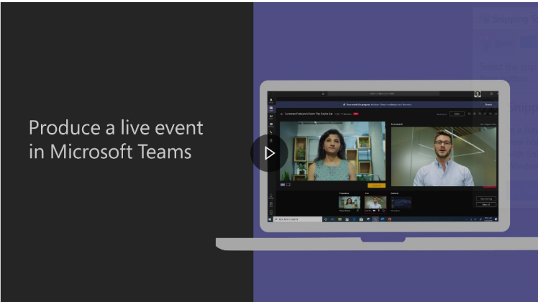
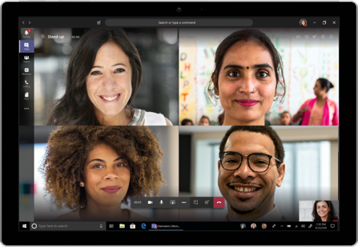
Collaborate
Don’t miss a beat by using technology to connect and collaborate regardless of location.
Ideate and iterate—real time
Share the content your audience needs to see with screen sharing, and work to edit in real time with coauthoring in Teams. If you need to brainstorm, use Whiteboard in Teams as a digital canvas for your ideas to come to life.
Switch to digital events
Keep your events on the books with Teams live events that allow you to broadcast video and meeting content to large online audiences. This can be used for anything from a team all-hands to external forums.
Virtual ‘huddle’
Quick meetings are effective at getting everyone on the same page quickly. Schedule a quick call with your collaborators to get the same impact of a quick in-person connection.
Use the Microsoft Whiteboard app in Teams. Watch a training on how to produce a Teams live event.

Slide 12
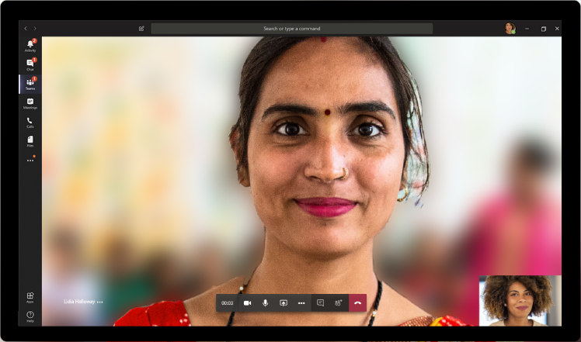
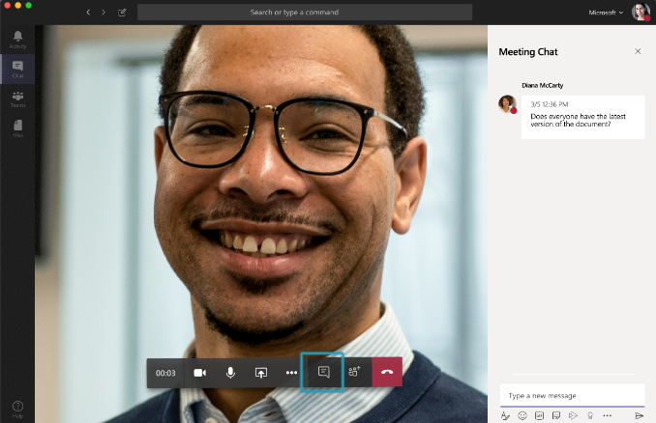
Lead inclusive online meetings
As you move your meetings online, take these steps to make them productive and welcoming for everyone.
Be present and respectful
Limit multitasking during meetings. Turning on your video can show that you are paying attention and allow you to focus on the person or people on your call. Blur your background to reduce distractions.
Pause for others to speak
It can be hard to find space to speak in a meeting, and even harder when everyone is virtual. Make sure there’s time and opportunity for all voices to be heard.
Monitor meeting chat
People may not feel comfortable breaking into the conversation or may be having technical difficulties. Check the Teams meeting chat often for comments.
Make sure all meetings have a virtual “join” option to create an online conference room.
Record meetings in Teams and share the recording link in chat so people can catch up later.

Slide 13

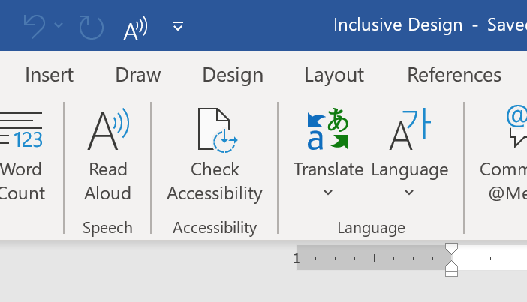
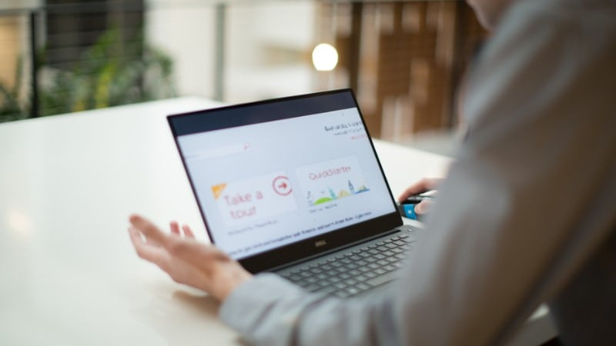
Think about accessibility
Follow these simple tips to be inclusive of colleagues and customers with disabilities.
Turn on live captions
Turn on live captions in Microsoft Teams to get real-time captions during your call. If posting a video use Microsoft Stream to automatically add real-time captions and searchable transcript.
Make sure your content is accessible
Send materials ahead of your meeting and use Accessibility Checker to check your Microsoft 365 documents are inclusive to people with disabilities. Remember ~70% of disability is invisible; you never know who needs accessible content.
Make Windows 10 easier to see
Is your cursor hard to see, need to increase font size or need to distinguish colors easily? You can change all these and more in Windows 10 Ease of Access Center.
For more hints and tips on accessibility check out the Accessibility site.
If you are a person with disability needing assistance with accessibility features, contact the Disability Answer Desk.

Slide 14
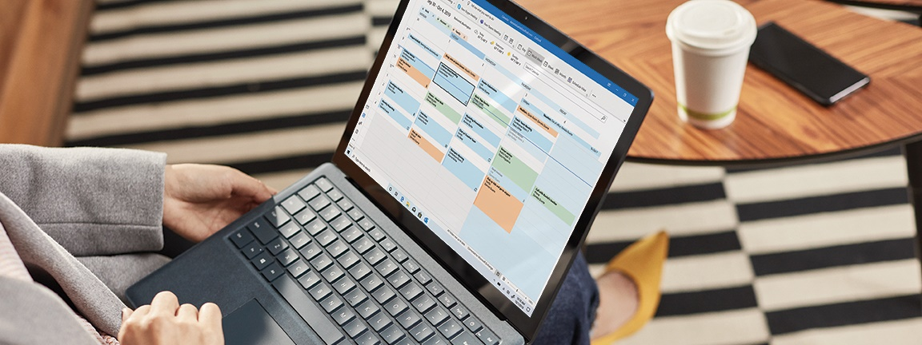
Manage your time and well-being

Slide 15
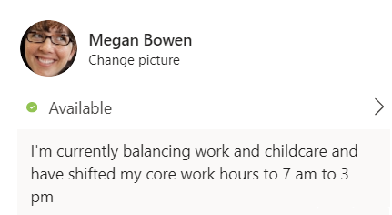
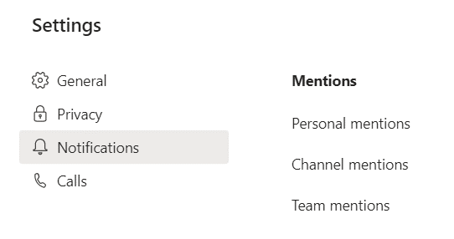

Share your schedule and signal availability
Setting healthy boundaries, managing interruptions, and being clear about when you are available is an important part of managing your time when working from home.
Set expectations for availability
Your daily schedule or even the hours that you work may change while working from home. Set expectations with your team (and those you live with) around your availability during the day.
See what is important
With everybody working from home, you might see an increase in messages. Use the settings available in Teams and Outlook to customize notifications and prioritize conversations.
Set boundaries
It can be a challenge to switch ‘off’ from work when you don’t leave the office—or switch ‘on’ your workday when you don’t leave the house. If needed, set clear intentions about work time and home time to avoid burnout or being ‘always on’.
Manage notifications for Teams activities, channels, and on mobile.
Set a status message in Teams and update your calendar to indicate if you are free or busy.
Set quiet hours in Teams mobile to limit notifications to your work hours and turn Focus Assist on in Windows 10.

Slide 16



Take care and be mindful
In challenging circumstances, we need to remember to take a step back and focus on our health, wellness, and mindset.
Don’t forget to take breaks
It can be difficult to remember to take breaks. Use your calendar to turn meals and breaks into appointments so you get regular reminders. Block time on your calendar for exercise and fresh air—or just time to step away from your workspace.
Work-life harmony
We recognize that while working from home you may need to occasionally redirect your time and energy to your loved ones. Continue to access available support options, caregiver benefits, and leave, as needed, to find the balance you need.
Check-in with you (and others)
It’s important to check in with yourself and be mindful of how you are feeling. Anxiety, loneliness, and other feelings are perfectly normal, and we have resources to help you take care. Be sure to check in on others within your community.
Notes:
Additional information that can be added to this page:
How access wellness resources and benefits offered by your company

Slide 17
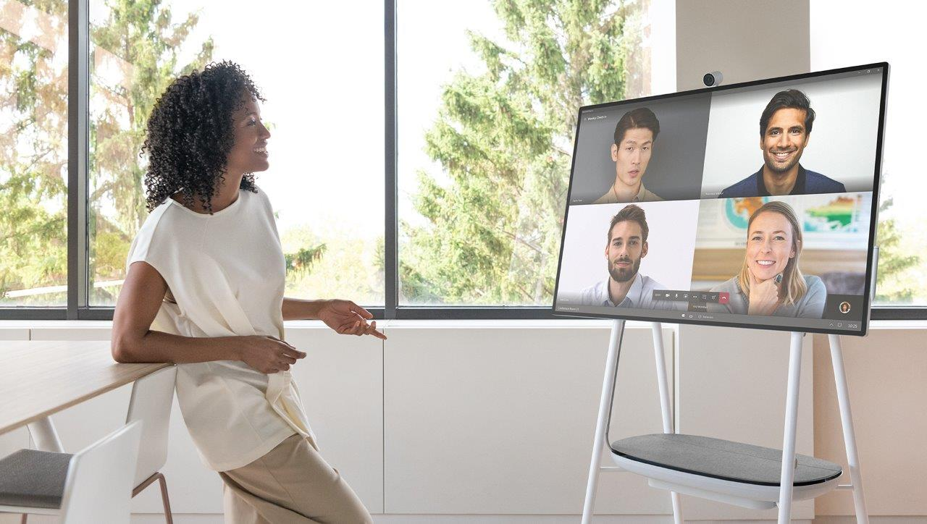
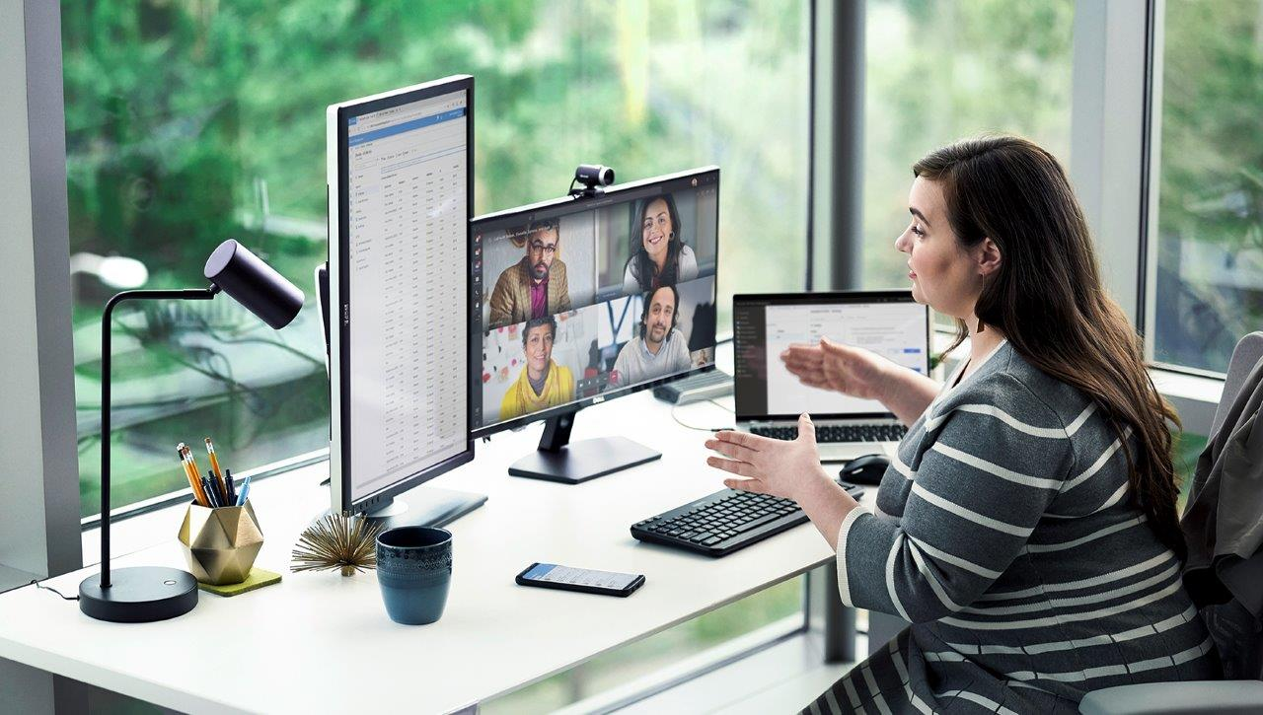
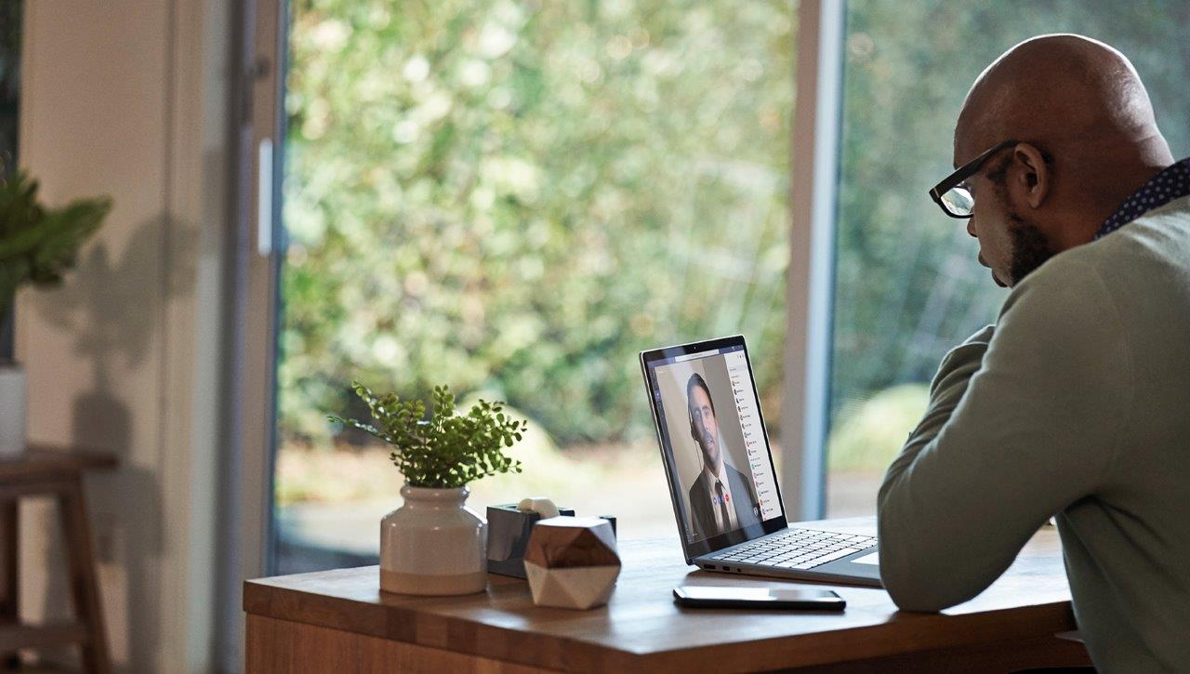
Role of the manager
Managers play a key role in the success of their teams, especially during times of uncertainty and change.
Lead by example
Model the work from home habits in this document. Be a positive example of the guidance, and make sure to reinforce inclusion. Check in with your employees, ask for perspectives, and identify any areas for improvement.
Support in new ways
Help each person create their best and most productive work from home environment. Understand any business continuity concerns of your team and support their efforts at working in new ways. Be curious and ask questions that empower employees to find their own solutions.
Frequent check-ins
These are unusual times with unanticipated challenges and may require more frequent check-ins. Students may be out of school. Be sure to manage expectations, offer support, and take time to understand the unique needs of every employee.
Notes:
Additional information that can be added to this page:
Learning resources for managers

Slide 18
Learn more
Notes:
Additional information that can be added to this page:
links to additional information and resources

